Slide 1
PROJECT TITLE
PIP2001 Capstone Project
Review-1
Batch Number:PSCS_64
Under the Supervision of,
Dr.N Thrimoorthy-Asst.professor
School of Computer Science and Engineering
Presidency University
Roll Number | Student Name
20211CSE0535 | Sumeeth sangat
20211CSE0552 | BH Pavan Kumar
20211CSE0575 | Vijeth Huhar
Name of the Program: PIP4004
Name of the HoD: Mohammed.Asif T
Name of the Program Project Coordinator:
Name of the School Project Coordinators: Dr. Sampath A K / Dr. Abdul Khadar A / Mr. Md Ziaur Rahman

Slide 2
Introduction
The PG Dissertation Management System is a web-based platform designed to streamline the dissertation submission, evaluation, and tracking process for postgraduate students. Traditional paper-based methods often lead to inefficiencies, delays, and mismanagement. This system provides a centralized digital solution where students can submit their research work, faculty can review and provide feedback, and administrators can track progress effortlessly. Key features include automated notifications, plagiarism detection, secure storage, and real-time progress monitoring.

Slide 3
Literature Review
This section includes a review of existing dissertation management systems, their functionalities, and their limitations. You can compare:
Manual Submission Process – Challenges such as paperwork, loss of documents, and mismanagement.
Existing Digital Solutions – Some universities use LMS (Learning Management Systems) like Moodle, but they lack dedicated features for dissertation tracking.
Gap Analysis – Identifying the need for a system that integrates automated submission tracking, plagiarism checks, and real-time progress monitoring.

Slide 4
Existing method Drawback
Paper-based submissions result in delays and mismanagement.
Lack of centralized tracking and progress monitoring.
Limited collaboration between students, guides, and reviewers.
No automated plagiarism detection or feedback mechanism.

Slide 5
Proposed Method
The proposed PG Dissertation Management System is a web-based platform that will:
Allow students to submit their research work digitally.
Enable guides and evaluators to review and provide feedback.
Integrate plagiarism detection tools.
Automate notifications and reminders for deadlines.
Generate reports and track progress efficiently.

Slide 6
Objectives
Develop a user-friendly dissertation submission and system.
Reduce paperwork and manual errors.
Improve collaboration between students and faculty.
Enhance the review process with automated notifications.
Ensure secure and structured storage of research work.

Slide 7
Methodology/Modules
The system is divided into multiple modules:
Student Module – Upload dissertation, track status, receive feedback.
Faculty/Guide Module – Review and provide comments, approve/disapprove submissions.
Administrator Module – Manage users, configure system settings.
Plagiarism Detection Module – Ensure originality of work.
Progress Monitoring Module – Keep track of student submissions and approvals.

Slide 8
Architecture
A high-level architecture diagram includes:
Front-end: Web-based UI using React/Angular.
Back-end: Django/Node.js with RESTful API.
Database: MySQL/MongoDB for storing user and document data.
Cloud Integration: For document storage (AWS/GCP).

Slide 9
Hardware/software components
Hardware: Server with hosting capabilities, computer with internet access.
Software:
Front-end: HTML, CSS, JavaScript (React/Angular)
Back-end: Node.js/Django
Database: MySQL/MongoDB
Cloud Storage: AWS S3 or Google Drive API

Slide 10
Timeline of Project
Week 1-2: Requirement gathering & literature review.
Week 3-4: System design and architecture finalization.
Week 5-7: Front-end and back-end development.
Week 8-9: Integration and testing.
Week 10-12: Deployment and documentation.

Slide 11
Expected Outcomes
A fully functional dissertation management system.
Improved efficiency in dissertation submission and evaluation.
A centralized system for tracking student research progress.
Reduced manual paperwork and better transparency in the review process.

Slide 12
Conclusion
The PG Dissertation Management System enhances the dissertation submission and evaluation process by providing a digital platform for students, faculty, and administrators. It eliminates paperwork, ensures efficient tracking, and improves collaboration through automated notifications and feedback. With features like plagiarism detection, secure document storage, and real-time progress monitoring, the system streamlines academic research management. By reducing manual errors and increasing transparency, it benefits both students and educators.

Slide 13
Github Link
The Github link provided should have public access permission.
Github Link

Slide 14
References
Kumar, A., & Sharma, R. (2020). A Digital Approach to Thesis Submission and Evaluation in Higher Education Institutions. International Journal of Educational Technology.
Smith, J., & Brown, L. (2019). Online Dissertation Management Systems: A Comparative Study. Journal of Higher Education Research.
Patel, M., & Gupta, S. (2021). Enhancing Academic Workflow through Digital Dissertation Management Platforms. IEEE Xplore.
Existing Systems & Reports
Turnitin & iThenticate – Plagiarism detection tools used in academic research.
Moodle LMS – A learning management system used for assignment and dissertation submissions.

Slide 15
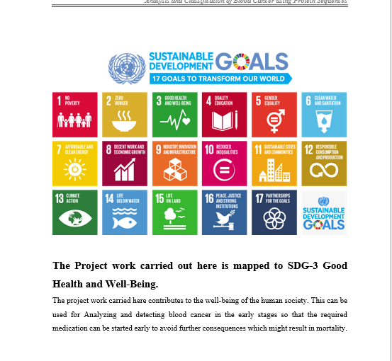
Project work mapping with SDG

Slide 16
Thank You

